Slide 1


Slide 2

Topics
Recap of Week 1
Recap OF Week 2
Types of Data and Variables
Interaction Variable
Feature Engineering
Feature Scaling
Feature Selection

Slide 3
Week 1 - Introductions
Data Science as a field is an intersection between mathematics, computer science, and domain expertise
There are 4 types of Analytics:
Descriptive – describes what has happened
Diagnostics – focuses on why it happened
Predictive – what is most likely going to happen soon
Prescriptive - suggests a course of action
Data Science = building > ML = Learning > AI = Practice
Statistics focuses on data assumptions; feature meaning is significant, model fitting is performed, parametric form
ML focuses on predictions, features don’t mean much as long as accuracy is high, model training and validation is performed, non-parametric forms mostly
Big Data Analytics only differ in data management and storage, analytics is same
Python is used for ML, R is suitable for statistics
w3school for learning python
Statquest for in-depth theory

Slide 4














Slide 5
Week 2 – Collecting & Exploring Data
4 types of data collection
Cross-sectional >> widely used in regression and classification problems
Time-Series >> widely used in forecasting based on historical data
Panel data >> cross-sectional data defined by regular time index
Pooled data >> irregular multi-period data, often with an event in between
Probability Sampling
Simple Random
Stratified
Systematic
Clustered
Non-probability Sampling
Convenience
Purposive
Snowball
Quota

Slide 6

Week 2 – Collecting & Exploring Data
Correlation (r): deals with association of two variables, -1 ≤ r ≤ 1. Correlation is positive, negative, and zero
$Correlation Coefficient= \frac{Cov(x,y)}{\sqrt{Var\left(x\right)}\sqrt{Var(y)}}$
Covariance vs Correlation
Pearson Coefficient : numeric x numeric
Spearman Coefficient: ordinal x numeric
Kendal tau: ordinal x ordinal
Correlation ≠ Causation
Contingency table demonstrate probabilistic relationships between several categorical variable
Line chart is used for plotting time indexed data, scatter demonstrates pattern between 2 variables, bar plots categories against a common numeric value, histogram plots intervals, pie chart plots categorical aggregates.
PandasGUI in Anaconda

Slide 7
Types of Data and Variables

Slide 8
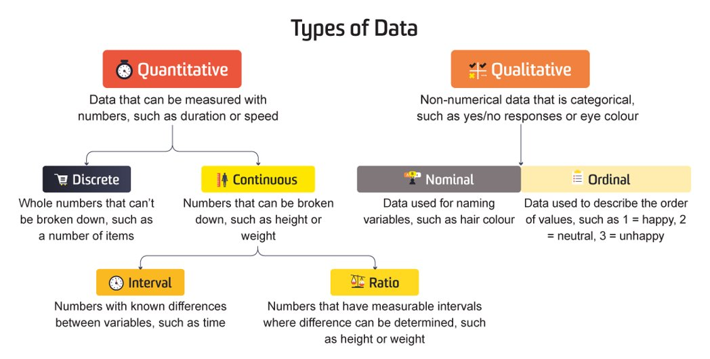
Types of Data

Slide 9
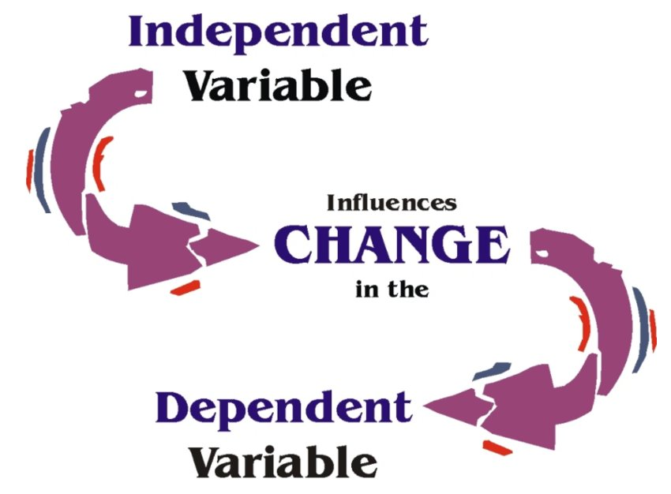
Types of Variables
Notes:
Response Variable: It is the focus of a question in a study or experiment. It is the variable we want to predict or observe. It is the dependent variable.
Explanatory Variable: It is the variable on whom the response variable depends, or the variable which ‘explains’ the response variable. It is assumed to be independent variable.

Slide 10








Interaction Variable

Slide 11
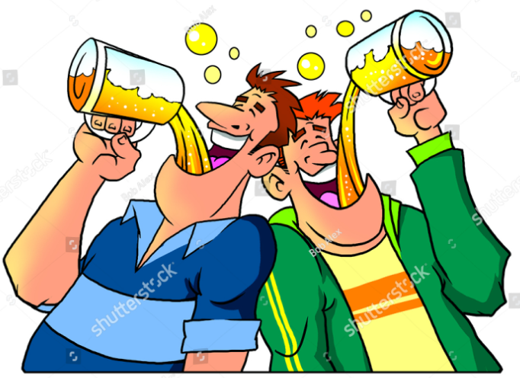

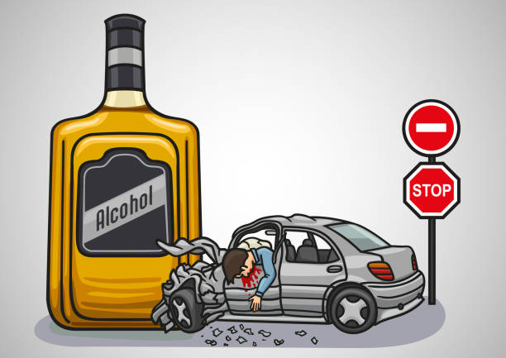
What is Interaction Variable?
Combination of two or more variables working together to reflect the change in the dependent variable
Target Variable = Feature_1 + Feature_2 + (Feature_1 * Feature_2)
Drinking is fun
Drunk Driving is not fun
Driving is fun

Slide 12
Feature Engineering

Slide 13
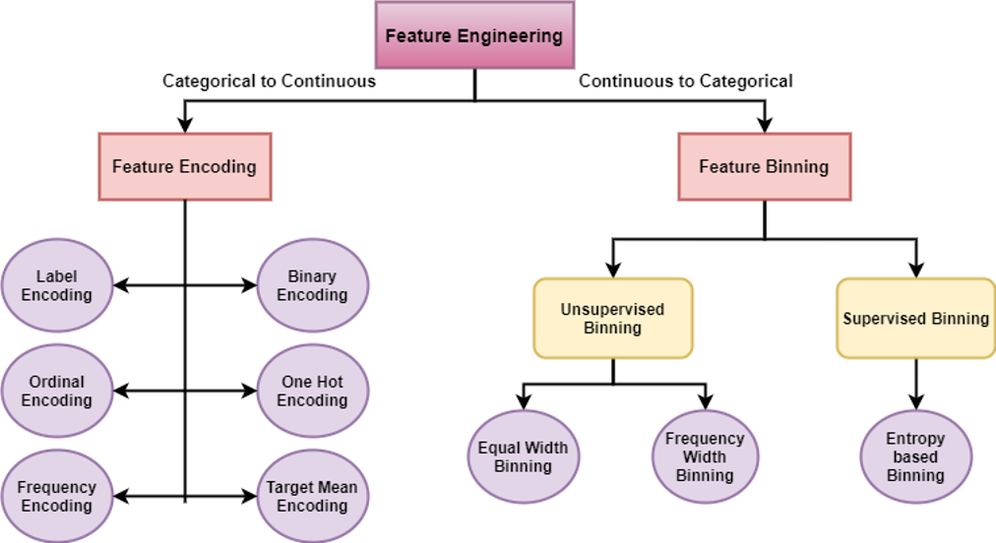
What is Feature Engineering?
Process of using domain knowledge to extract, transform, create, and scale features.

Slide 14
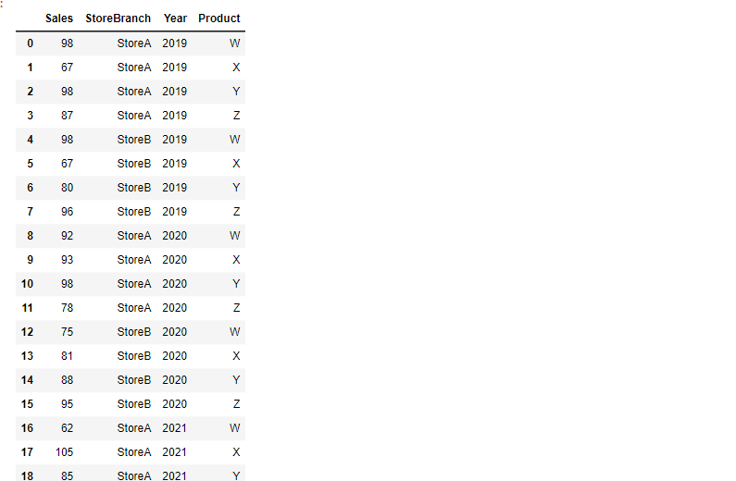


Slide 15
Feature Scaling

Slide 16
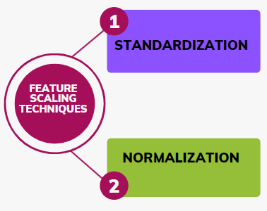
What is Feature Scaling?
Make sure features are on similar scale
Notes:
https://towardsai.net/p/l/which-feature-scaling-technique-to-use-standardization-vs-normalization

Slide 17
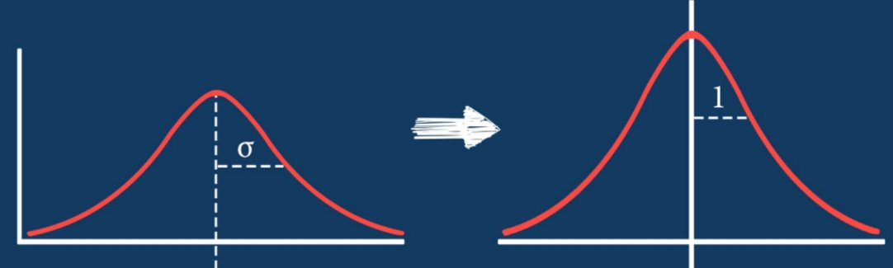

Standardization
Normalization

Slide 18
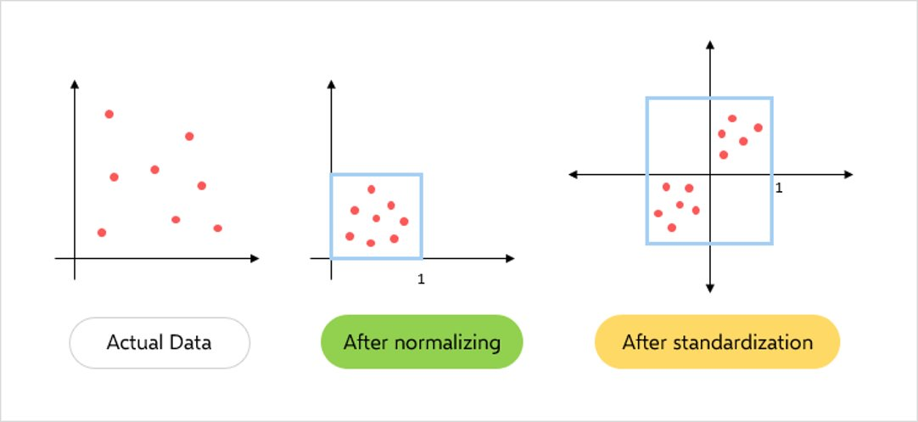

Slide 19
Feature Selection

Slide 20
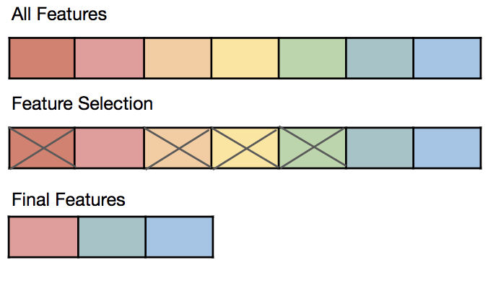
What is Feature Selection?
Process of selecting the most important features to be input in Machine Learning models

Slide 21
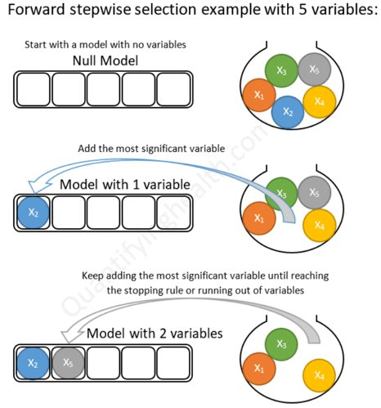
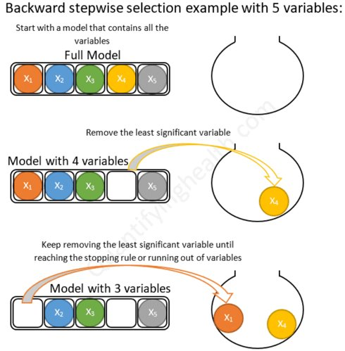
Forward and Backward

Slide 22

THANK YOU
Training and Certification

